Slide 1
Flexibility costs of debt: Danish exporters during the cartoon crisis
Benjamin U. Friedrich
Northwestern University, Kellogg School of Managemen
Aarhus University, Department of Economics and Business Economics
Michał Zator
University of Notre Dame, Mendoza College of Business
Journal of Financial Economics
March 2023
Presented by: Yan Li

Slide 2
Research Goal/Question:
How do firms respond to an unexpected demand shock?
How important is financial flexibility considerations in firms’ capital structure decisions in times of crisis?

Slide 3
Cartoon crisis
In September 2005, a Danish newspaper published caricatures of prophet Muhammad, which is considered blasphemous by Muslims. The publication led to a widespread boycott of Danish products in Muslim countries, which affected Danish exporters for at least one year.

Slide 4
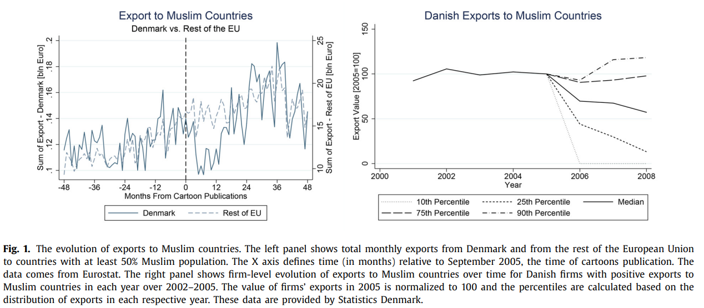
Cartoon crisis
At least 10% of these firms persistently lost their entire presence in Muslim countries, and effects for the median firm show a substantial export decline which these firms were unable to recover in subsequent years.
The figure shows that while exports from other European countries continued to grow over this period at their previous rate of around 10%, Danish exports experienced a sudden drop and remained at 25% below their previous level for more than one year

Slide 5
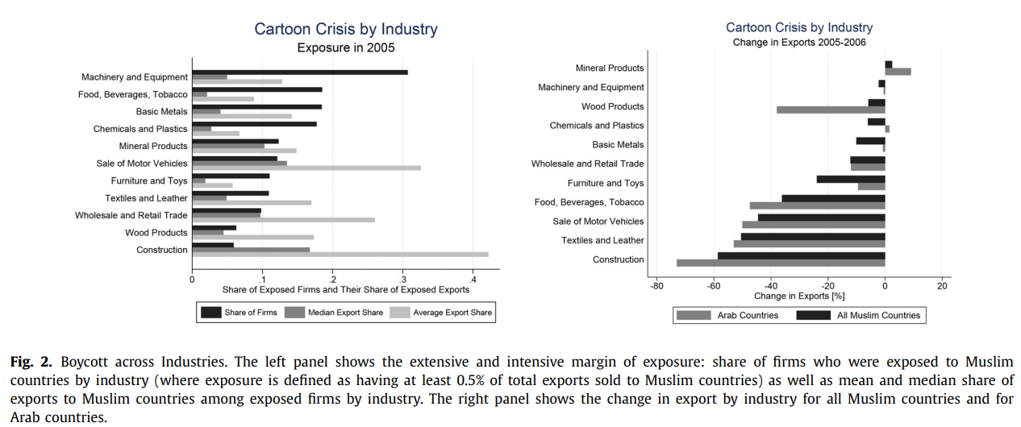
Cartoon crisis
The boycott was most salient in the Arab countries, observed export changes are similar as those for Muslim countries as a whole
Construction and consumer products experienced the largest drop in exports

Slide 6
Data
The Danish Foreign Trade Statistics Register (UHDI): annual firm-level trade value by product-destination pairs at the CN-8-digit product level
The Accounting Register (FIRE): financial statements of firms
The Danish Business Register (FIRM): additional information on founding date, sales, employment, industry, and firm exit
Danish banks: loan-level data on secured and unsecured loans (excluding mortgages) issued to Danish firms
Use firm identifiers from the Firm-Integrated Database for Labor Market Research (FIDA) to match firm level data with worker-level information from the Danish Integrated Database for Labor Market Research (IDA)

Slide 7
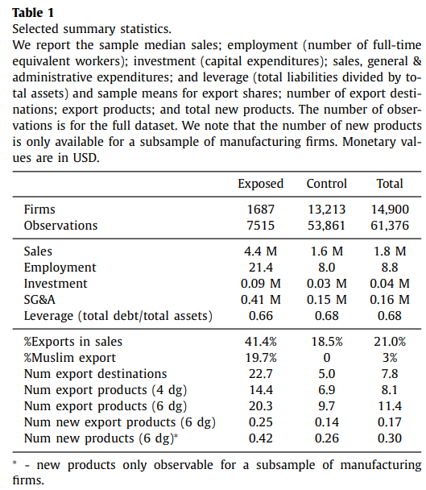
Selected Summary Statistics
Exposed firms are over two times larger compared to control-group firms and significantly more export-oriented
Muslim markets are rather distant and exotic markets for Danish firms, and hence are not typically served by very small firms

Slide 8
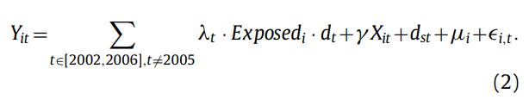

Empirical strategy
A difference-in-differences specification (DiD) that compares firms exposed to Muslim markets to other exporters pre- and post-boycott
Compares firms exposed to Muslim markets to other exporters pre- and post-boycott:
dst: industry-year fixed effects
μ_{i}: firm-fixed effects
Estimate an event-study regression extending Eq. (1) and subsequently plot the annual coefficient estimates capturing differences between groups, λt, where we normalize the coefficient in the year before the boycott to zero, λ2005 = 0.
To estimate the heterogeneous response to the boycott
d_{lte} and d_{hte} are indicators for low- and high leverage firms, respectively, interacted with year and exposure fixed effects (e.g., d_{lte} = Exposed_{i} · d_{l} · d_{t}) and we normalize δ_{l2005} = 0 and δ_{h2005} = 0

Slide 9
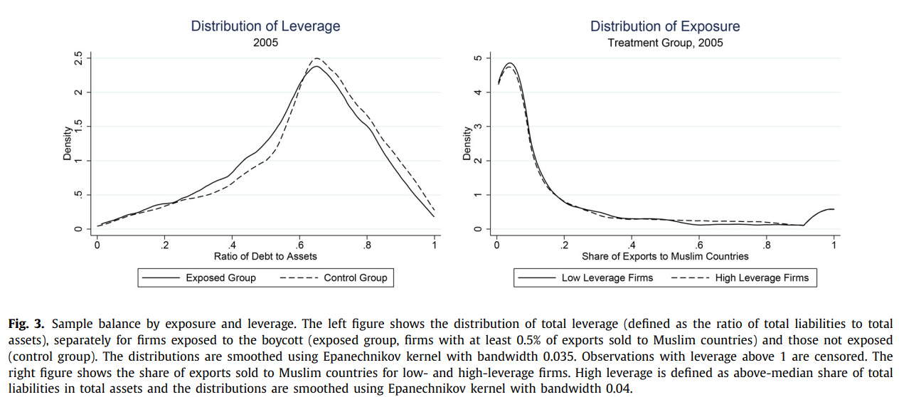
Heterogeneity by capital structure – identifying variation
similar distributions of leverage
no statistical difference in the degree of exposure between the two groups

Slide 10
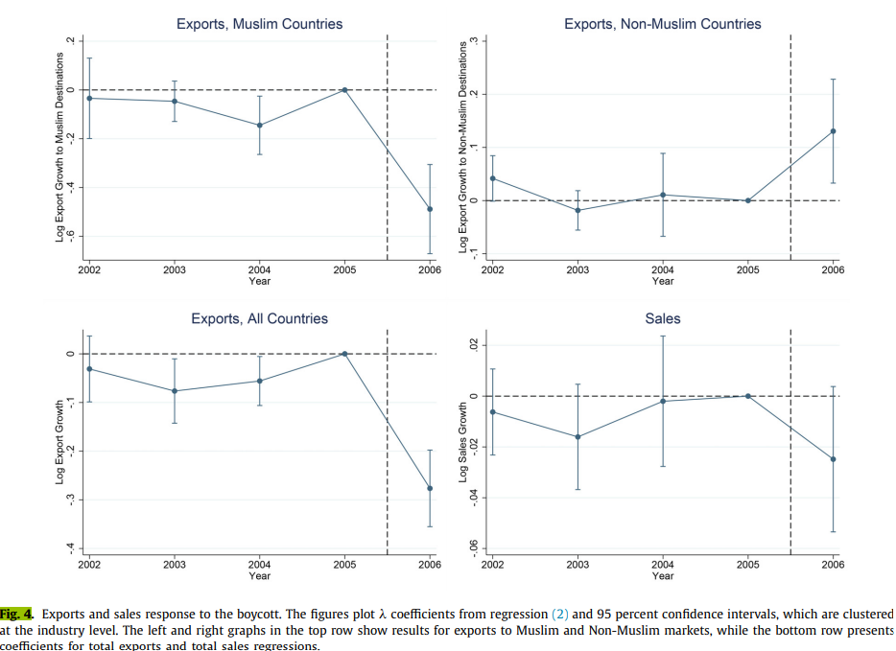
Average response to the boycott
After the boycott, there is a significant decline in the exports to Muslim markets, accompanied by an increase in exports to non-Muslim markets
a large and statistically significant decline in total exports, and a smaller decline in total sales that is only significant at 10% level

Slide 11

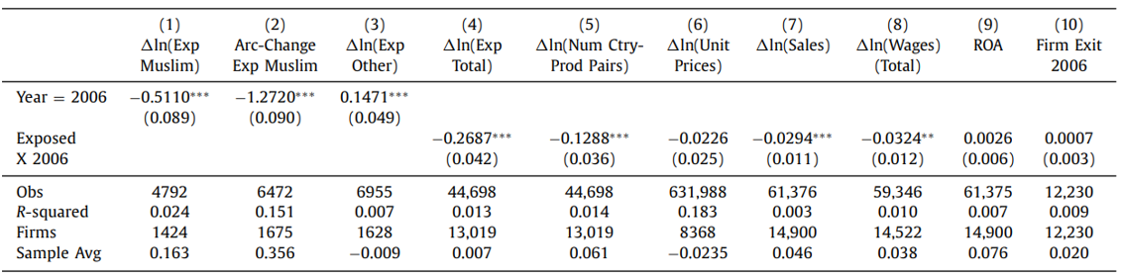
Average response to the boycott
Arc-percent changes accounts for that 26.2% of exposed firms stopped exporting to Muslim countries all together
Columns 1 and 2: a dramatic decline of export activity to Muslim markets
Column 3: the estimates for log-changes of exports to non-Muslim markets
Column 4: significant decline to total export market
Column 5: a significant decline in the number of product-country pairs served
Column 6: Unit prices at the HS-6 product level did not change differentially
columns 7 and 8 suggest that the boycott led to a decline in sales and employment

Slide 12

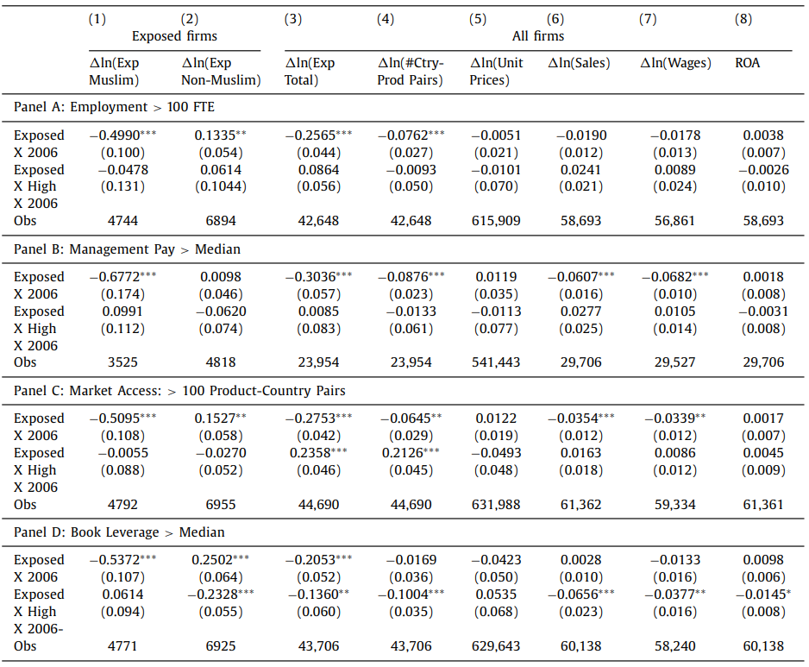
Heterogeneity analysis
Panel A & B: large firms and firms with higher paid managers do slightly better in terms of total sales and employment, but nonsignificant
Panel C: firms with larger product-market portfolio do better in terms of total exports (column 3), firms that are already serving many markets before the boycott further increase the number of product-country pairs in their export portfolio, despite losing some sales in Muslim markets
Panel D: low leverage firms are more successful at increasing exports to other markets (column 2), and hence total exports decline more for high-leverage firms (column 3)

Slide 13
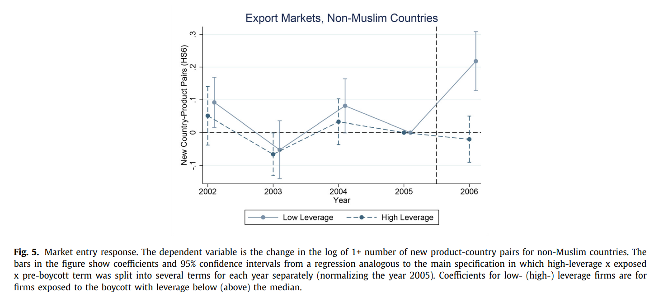
Market entry
low-leverage firms respond to the boycott by increasing the number of non-Muslim product country pairs in which they are present.
The response for high-leverage firms (dashed line) is close to zero and insignificant.

Slide 14
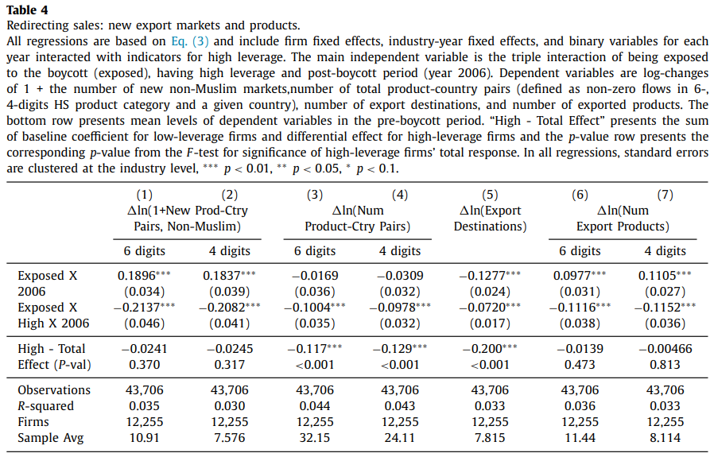
Market entry
low-leverage firms increase their entry into new non-Muslim markets, which allows them to keep the total number of product-country pairs unchanged : due to the boycott, the total number of countries they serve decreases, but they stabilize the number of markets they serve in part with an increase in the number of exported products

Slide 15
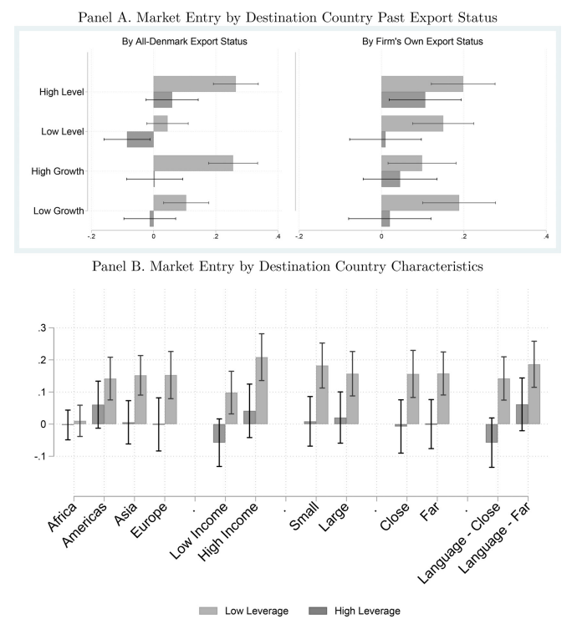
Country dimension of the market entry response
The top-left panel demonstrates that the market entry response of low-leverage firms is significantly larger for countries with above-average level and past growth in exports of all Danish firms before the boycott.
The top-right panel suggests that post-boycott market entry of low-leverage firms is also slightly stronger for markets where a given firm itself sold more in the past
no significant effects in any of the country groups for high-leverage firms, but significant effects for low-leverage firms in a large variety of market types

Slide 16
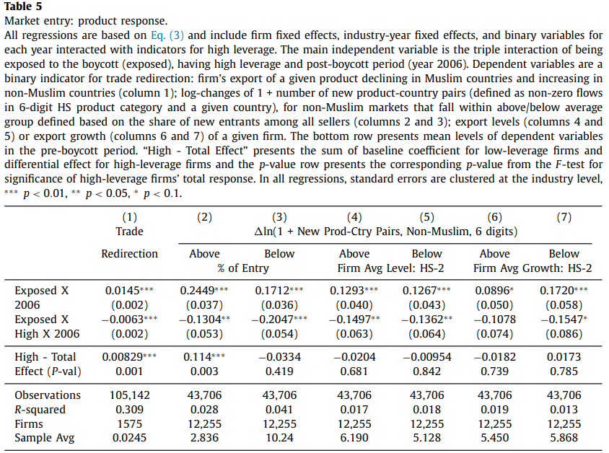
Product dimension of the market entry response
The share of firms redirecting trade towards non-Muslim countries
Trade direction response significant for both low and high leverage
Low leverage significant all: share of Entry; previously exported HS-2 product categories; firm’s past export growth
High leverage: only above share of Entry

Slide 17
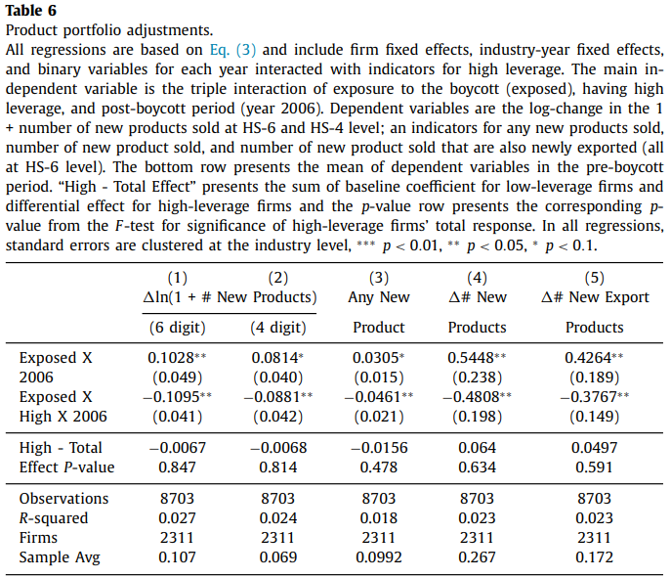
Product dimension of the market entry response
Low leverage firms exposed to the boycott introduce differentially more new products in 2006, compared to other firms and to their past behavior

Slide 18
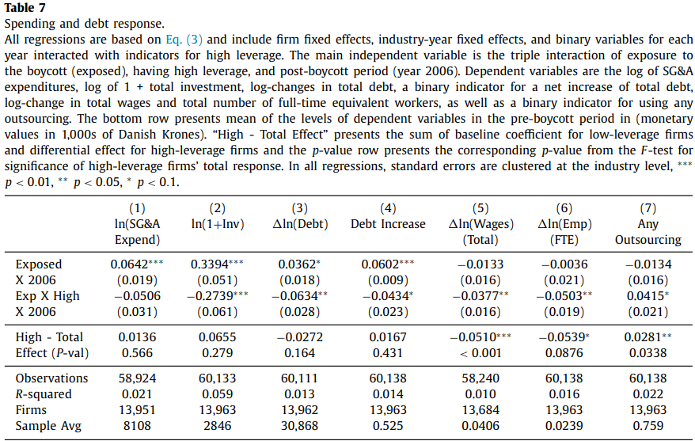
Spending and debt response
Low leverage firms increase in SG&A expenditure, investment, and debt while high leverage firms not.
Low leverage firms do not significantly change labor inputs while high leverage firms reduce their use of more rigid employment contracts and increase their flexibility by outsourcing

Slide 19
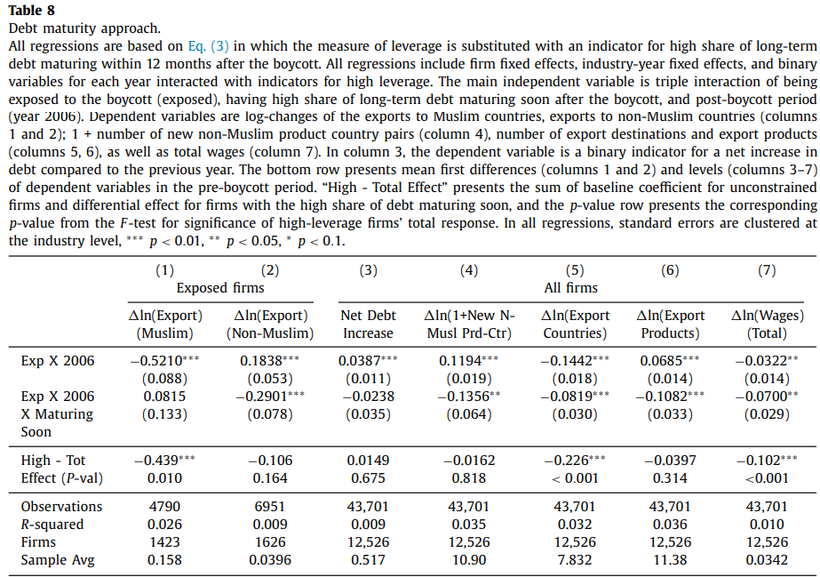
Differences in debt maturity
firms with debt maturing soon behave very similarly to firms with high leverage:
hit by the same shock as other firms and lose the same share of exports to Muslim countries but can’t recoup lost sales by increasing exports elsewhere
a significantly larger decline in destination countries and no increase in the number of exported product categories
Market entry

Slide 20
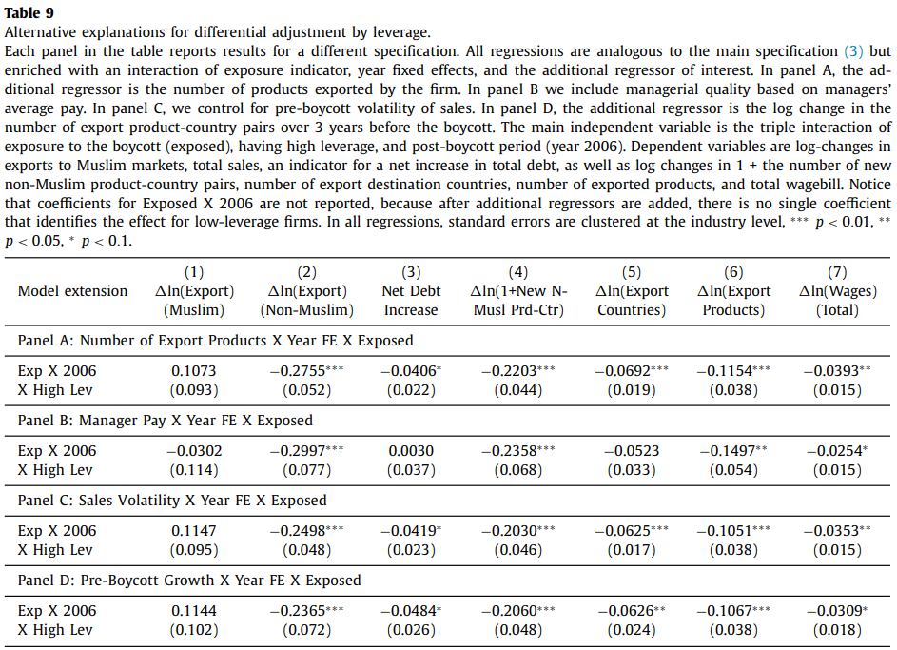
Alternative explanations
Some possible omitted factors that cause the documented differences between low- and high-leverage firms:
Number of Export Products
Manager Pay
Sales Volatility
Pre-Boycott Growth

Slide 21
Conclusions
Low leverage firms are able to enter new markets and recoup lost sales to counteract the negative demand shock
For high-leverage firms, the expansion response is muted and total sales and employment decline
Limitations:
- The shock studied is small, negative and affects only a subset of markets in which the firm operates. What results will be if studying a larger shock or a positive and broader shock?
- An important element that determines the relationship between capital structure and flexibility − the ability for debt renegotiation − is missing.
- The main results about firms’ adaptation to this shock capture short-term responses within one year after the boycott started but not later years

Slide 22
Marginal Contributions to Literature
Contribute to a larger literature on the impact of capital structure and financial constraints on real outcomes: The findings about the link between capital structure and firm’s ability to adapt to a shock extend the evidence from several studies that analyze flexibility in pricing (D’Acunto et al., 2018), production technology (Reinartz and Schmid, 2016), employment contracts (Simintzi et al., 2014; Serfling, 2016; Kuzmina, 2022), and the general link between financial and operational flexibility.

